Slide 1


The Ultimate Social Media
Audit Template

Slide 2


[Reporting period]
Social Media Audit
[Your brand]
[Reporting dates]

Slide 3

Competitive Landscape
[Enter reporting dates]

Slide 4
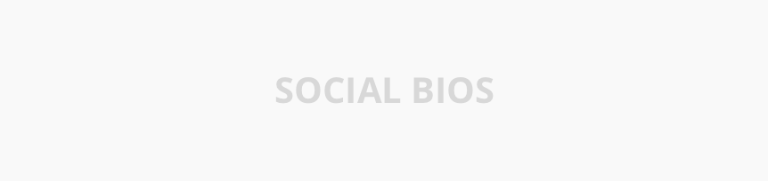


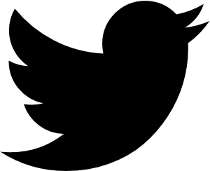
Profile Overview
[Enter reporting dates]
2-3 sentences about your social bios, including any hashtags or links you use.
Study your competitors' profiles across channels and make a note of details that stand out.
INSTAGRAM
TIKTOK
FACEBOOK
TWITTER

Slide 5

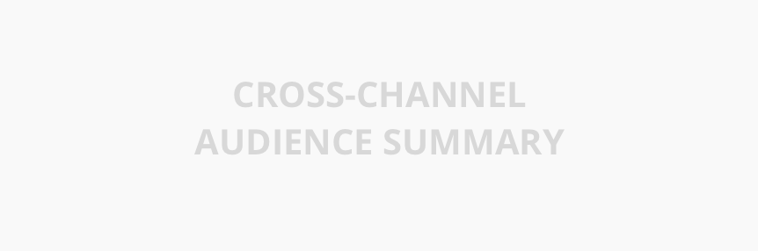
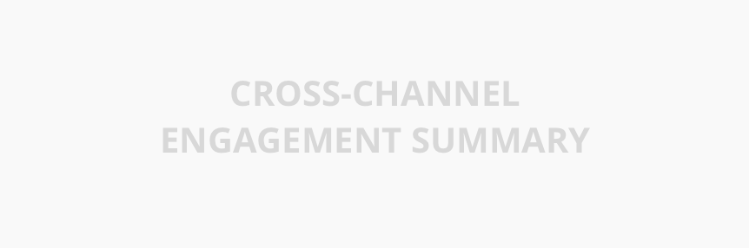
Cross-Channel Audience & Engagement
[Enter reporting dates]
AUDIENCE
ENGAGEMENT
1-2 sentences about your audience and how it changed compared to the previous period.
1-2 sentences about your overall engagement and how it changed compared to the previous period.

Slide 6
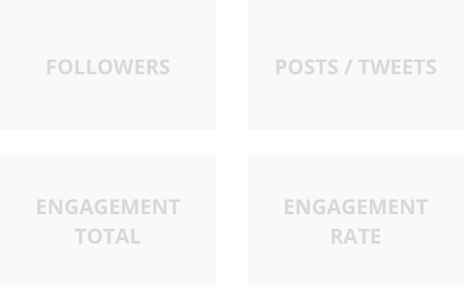
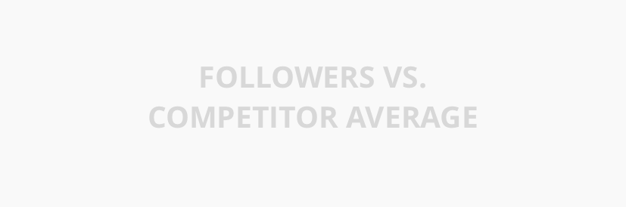
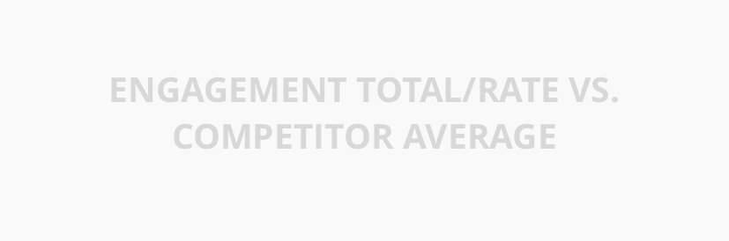
[channel]: Metrics Overview
[Enter reporting dates]
2-3 sentences about significant [channel] performance or changes.
Don’t forget to mention your competitive standing!

Slide 7
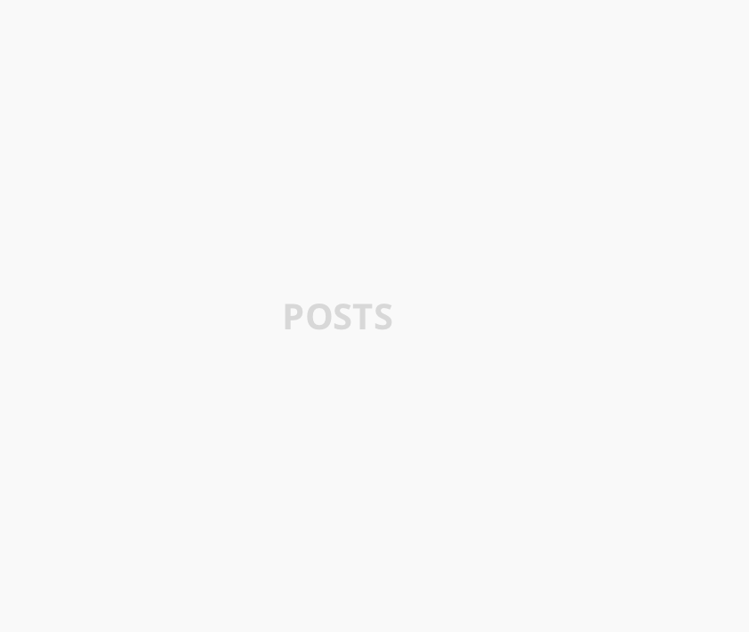
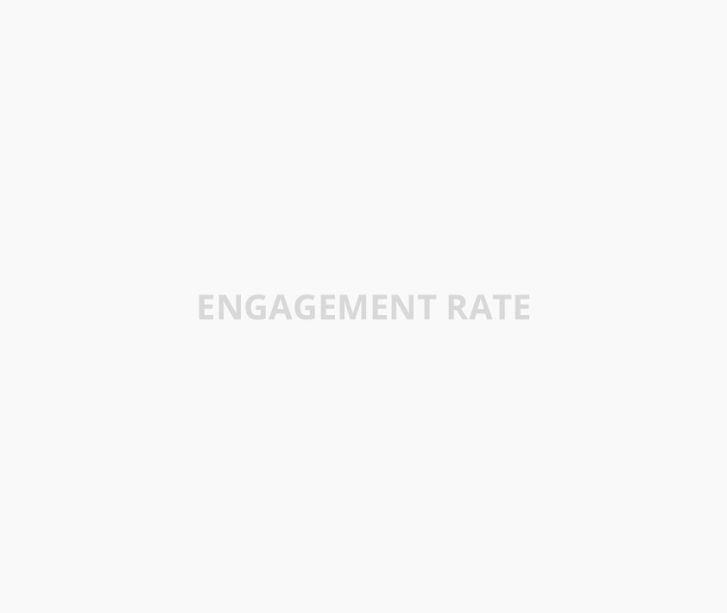
[channel]: Competitive Review
[Enter reporting dates]
2-3 sentences about your posting frequency and engagement rate standings on [channel].

Slide 8
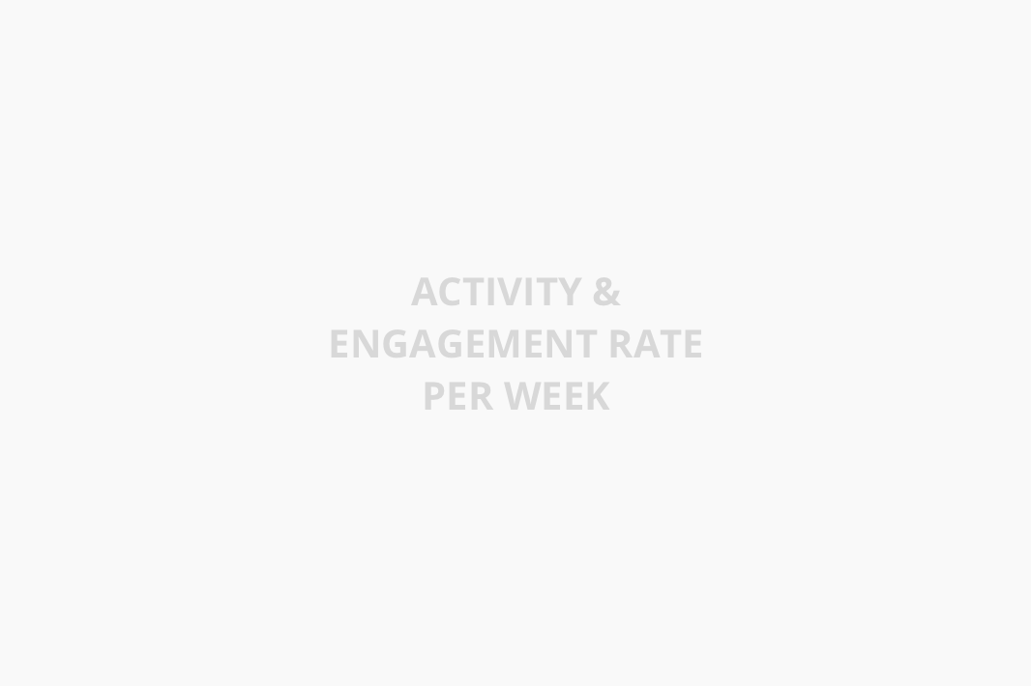
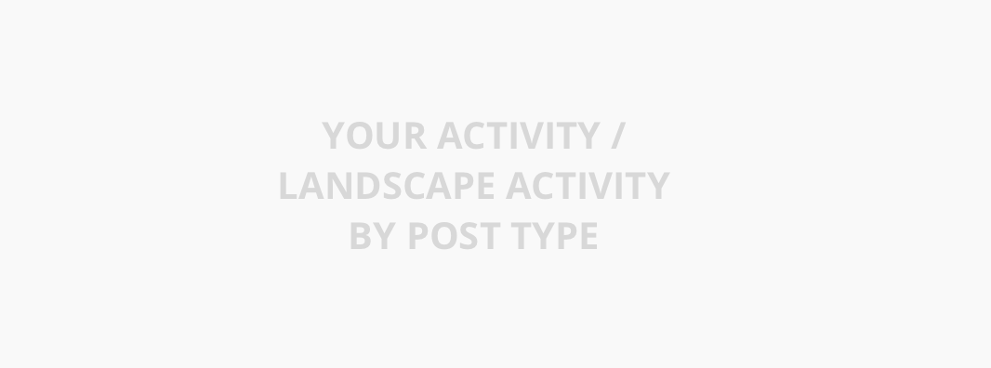
[channel]: Activity
[Enter reporting dates]
Include 1-2 notable observations about your posting activity and engagement rate trends compared to the landscape average.
1-2 sentences about your posting activity on [channel]. Don’t forget to mention if it is different from the landscape’s top post type!

Slide 9
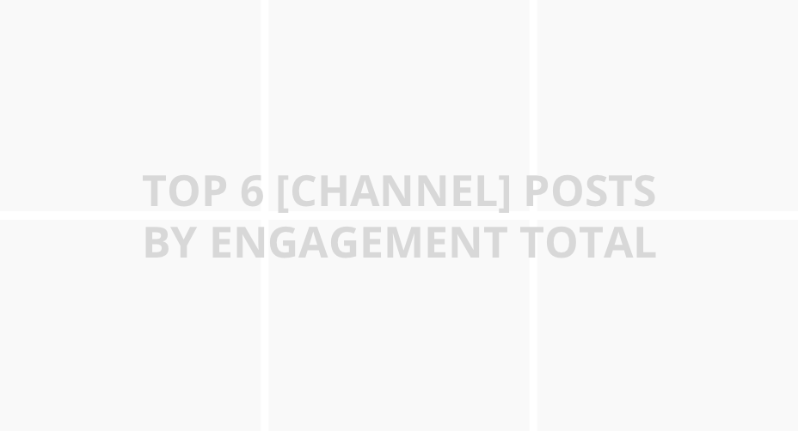
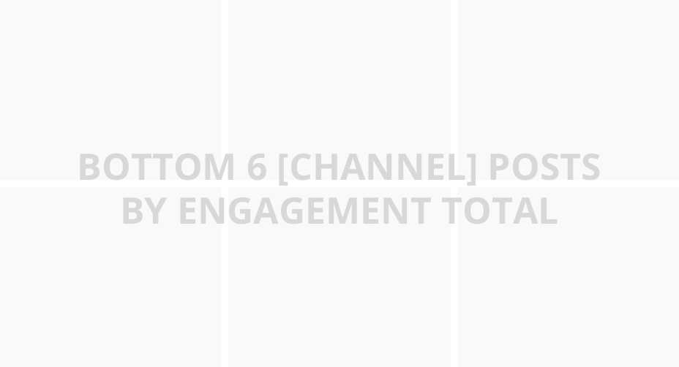
[channel]: Top vs. Bottom Posts
[Enter reporting dates]
TOP POSTS
BOTTOM POSTS
1-2 sentences about what made your [channel] posts stand out. Include a sentence about a top #hashtag or campaign.
1-2 sentences about your [channel] posts that performed the worst.
Top 6 posts averaged [XX] engagements per [post/tweet/video]

Slide 10




To-Do List
[Enter reporting dates]
1-4 things that worked well or that you want to try next.

Slide 11
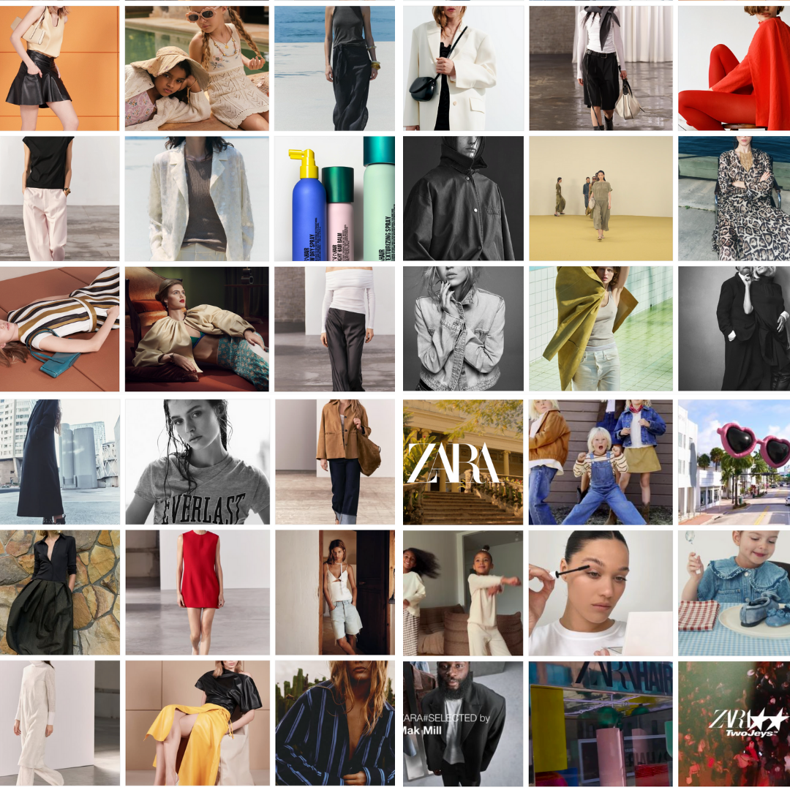

2024
Social Media Audit
January 1 – December 31, 2024

Slide 12




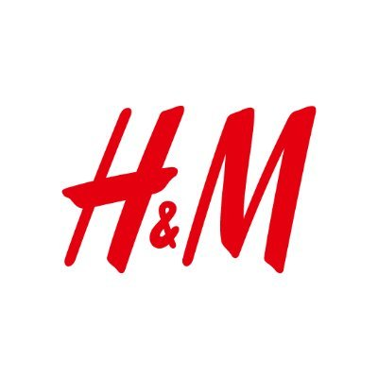
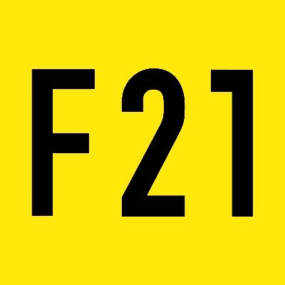
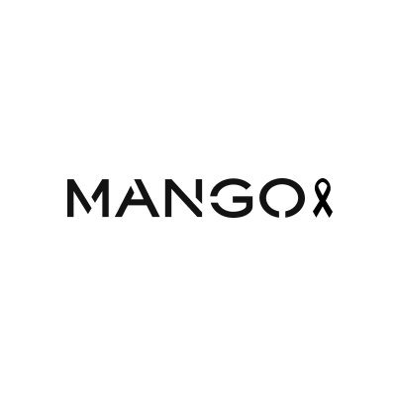

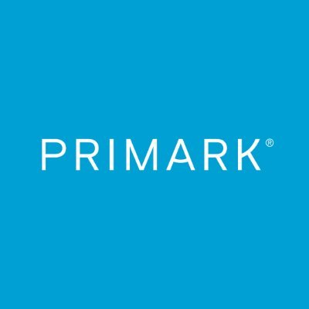
Competitive Landscape
January 1 – December 31, 2024

Slide 13
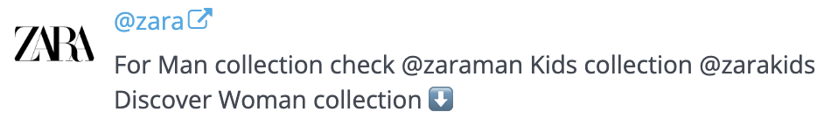
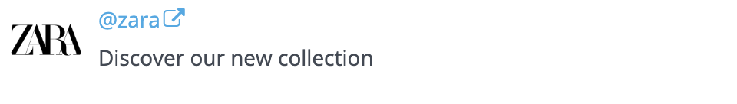
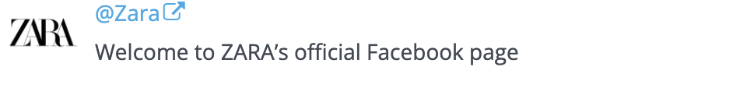
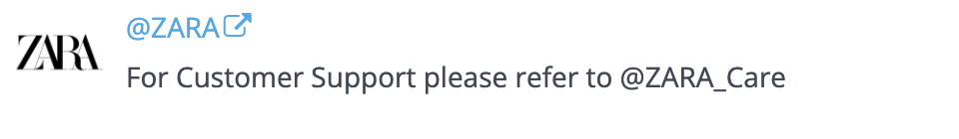
Profile Overview
January 1 – December 31, 2024
Nice job showcasing Zara’s Men, Women, and Kids collections in the social profiles.
Several brands in the landscape, like H&M and Mango, use emojis or hashtags in their bios to highlight trends or key values. Worth trying something similar for Zara? ✨
INSTAGRAM
TIKTOK
FACEBOOK
TWITTER

Slide 14
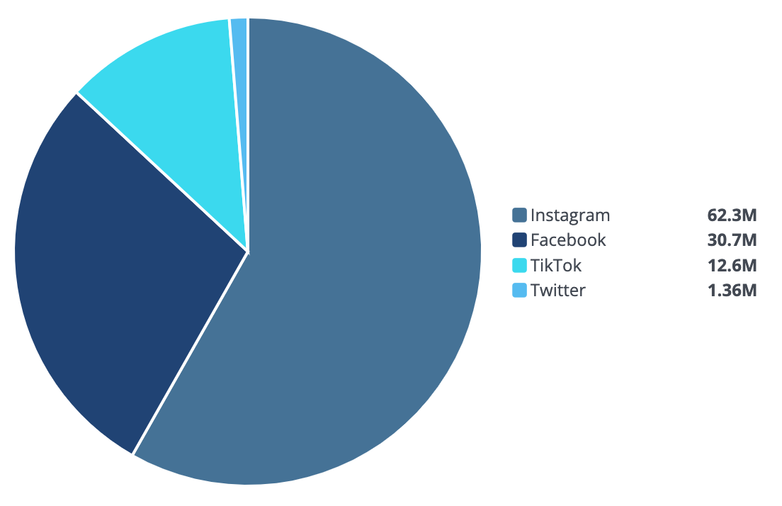
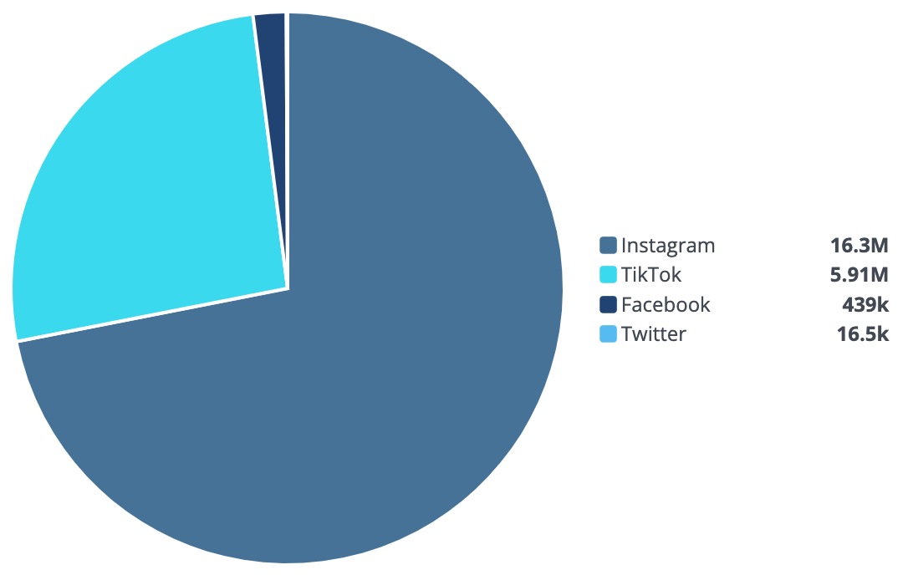
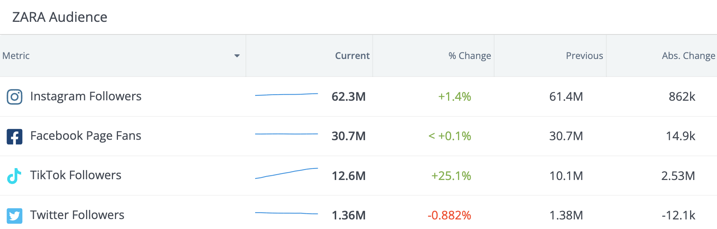
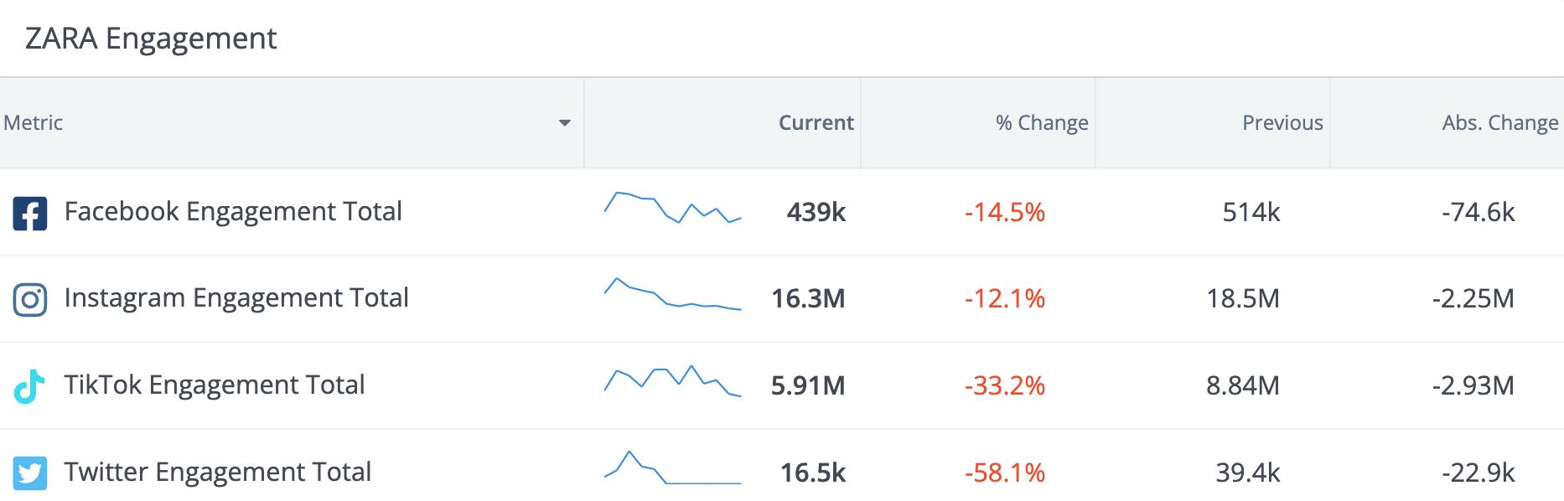
Cross-Channel Audience & Engagement
January 1 – December 31, 2024
AUDIENCE
ENGAGEMENT
Zara’s audience grew steadily this quarter, with the largest increase on TikTok, up by an impressive 25%. Nice work! 🎉
Instagram continues to be Zara’s most engaging channel, with 16.3M total engagements. However, TikTok experienced a significant drop despite the strongest growth in follower count.

Slide 15
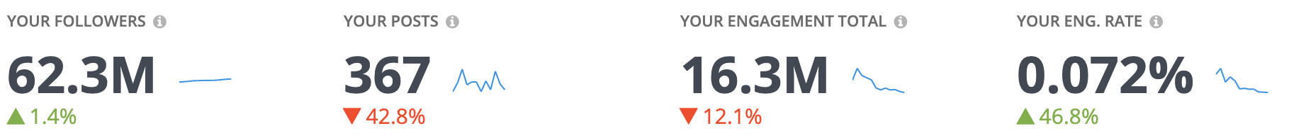
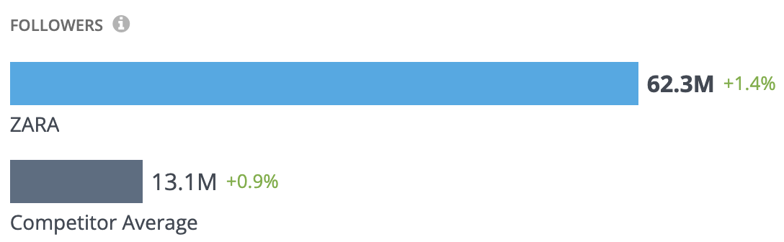
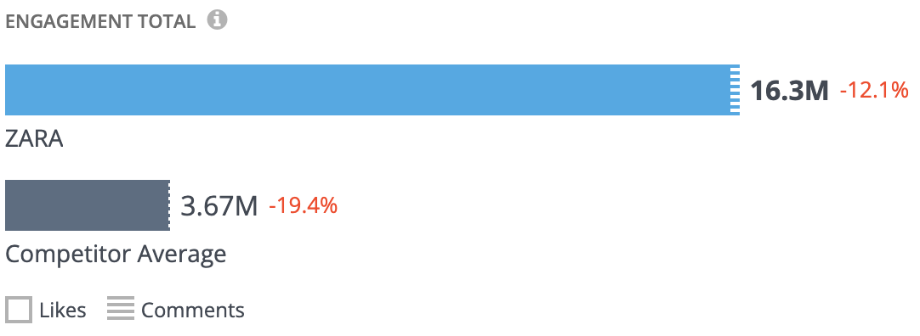
Instagram: Metrics Overview
January 1 – December 31, 2024
Zara dominates the competition with a massive 62.3M followers, far surpassing the competitor average of 13.1M, and keeps growing with a +1.4% increase.
While engagement totals of 16M remain strong, they dipped by 12%, signaling an opportunity to re-energize content and capitalize on their impressive reach. 📈✨
It’s also worth noting that the fashion retailer published 43% fewer posts during this period, which can help explain the drop.

Slide 16
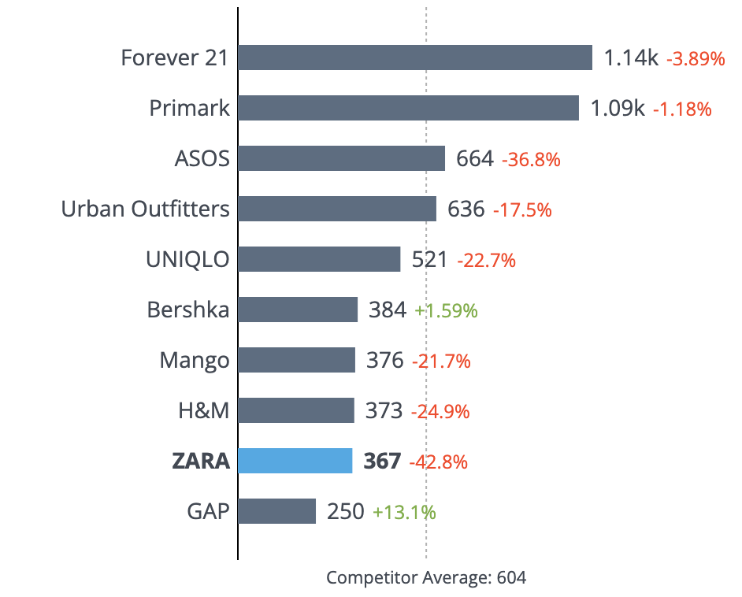
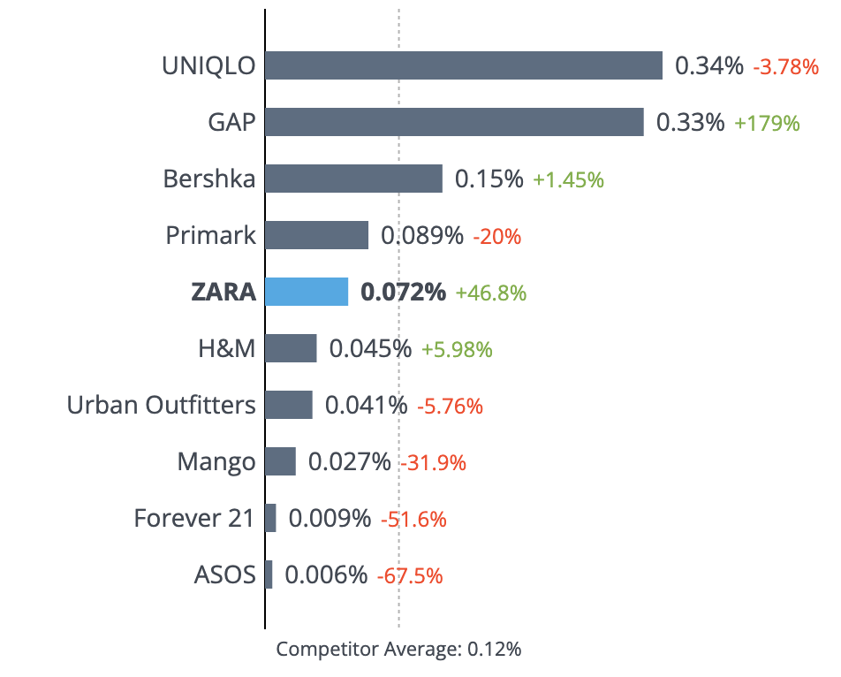
Instagram: Competitive Review
January 1 – December 31, 2024
POSTS
ENGAGEMENT RATE BY FOLLOWER
Zara posted an average of 367 times this period, nearly 50% below the competitor average of 604 posts. Despite a 43% drop in posting frequency, Zara’s engagement rate by follower rose by an impressive 47%, ranking 5th out of 10 companies and sitting just below the competitor average of 0.12%.

Slide 17
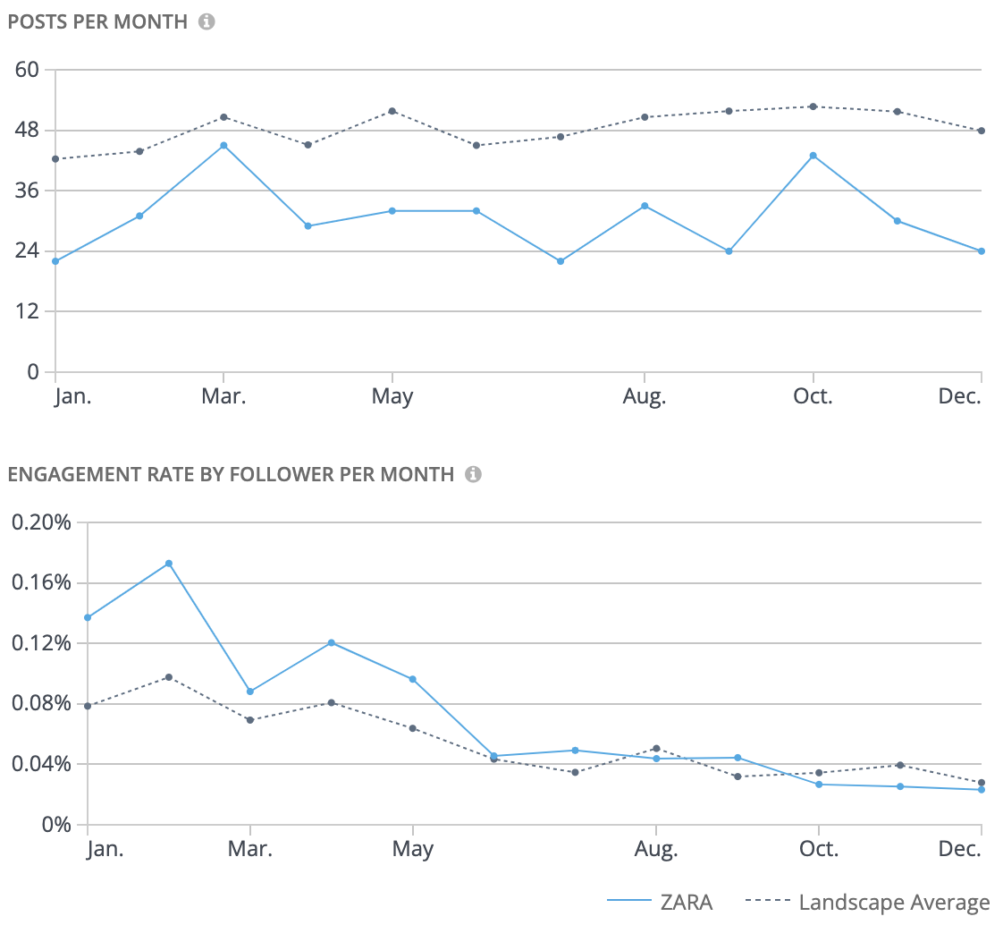
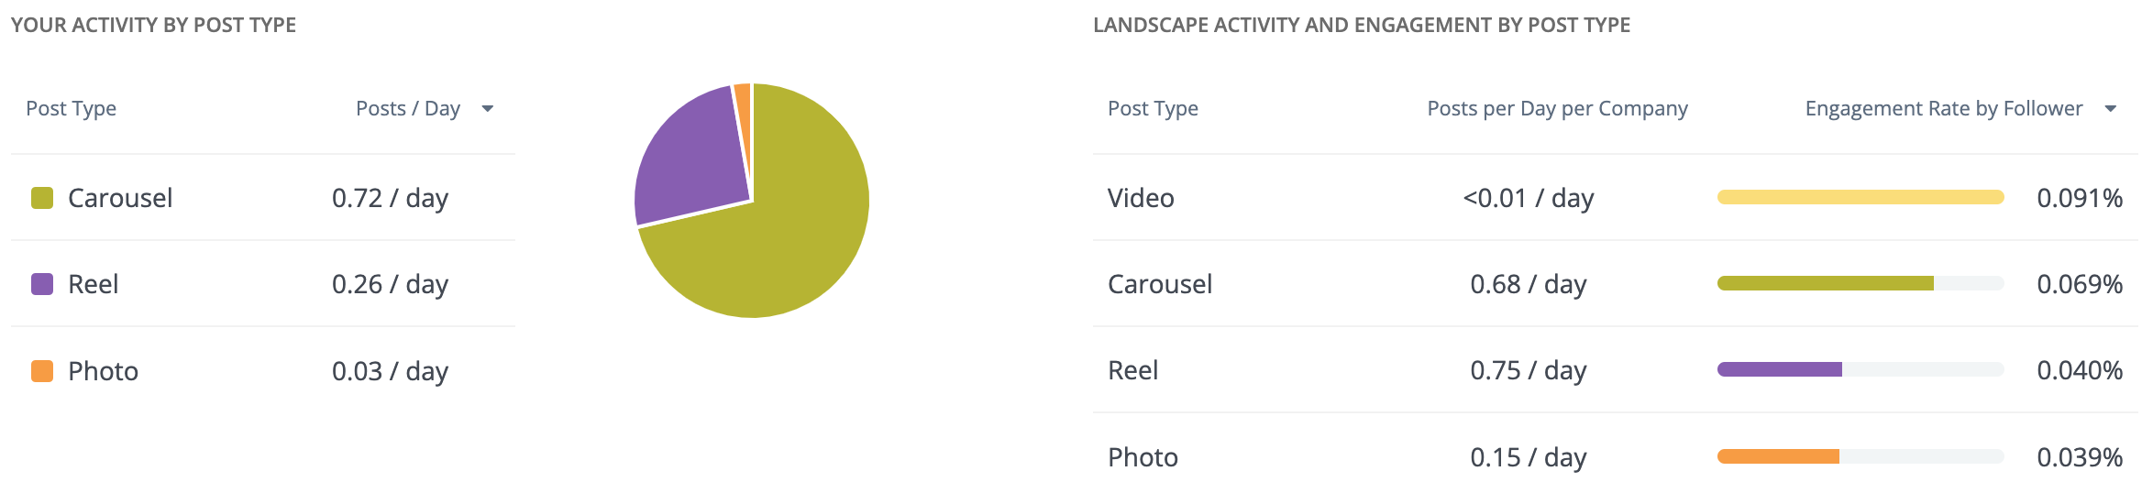
Instagram: Activity
January 1 – December 31, 2024
ACTIVITY & ENGAGEMENT
POST TYPES
Zara did not post as steadily as the competition. Interestingly, the brand’s engagement rate trend mirrored the industry, with peaks in February and April.
Carousels dominate Zara’s Instagram post type, making up 72% of their posts. Video generated the highest engagement in the landscape, even though it was the least common post type.

Slide 18
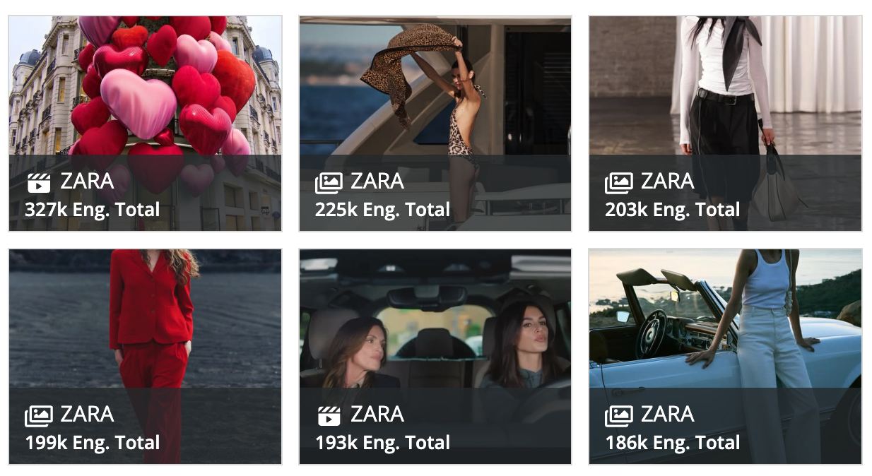
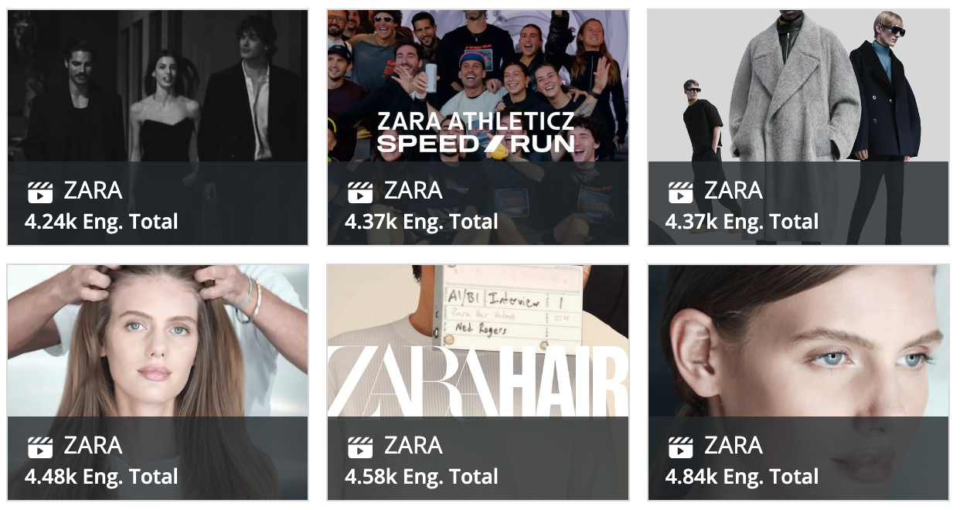
Instagram: Top vs. Bottom Posts
January 1 – December 31, 2024
TOP POSTS
BOTTOM POSTS
Zara’s top posts blend romance ❤️, effortless style, and star power. From the Valentine’s Day-themed post to the iconic campaign starring Cindy Crawford, these posts captivate with aspirational visuals and trendy hashtags like #zarawoman.
Zara’s worst-performing posts, focused on niche collections like Zara Hair Shine and Zara Athleticz, suggest that specialized campaigns may not resonate as strongly with the broader audience.
Top 6 posts averaged 222.2K engagements per post

Slide 19
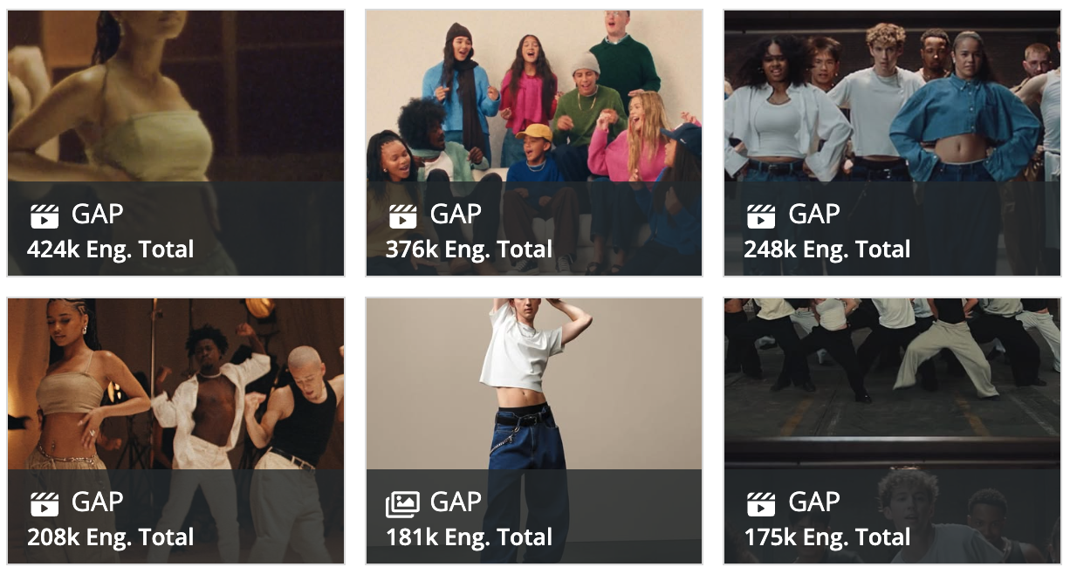
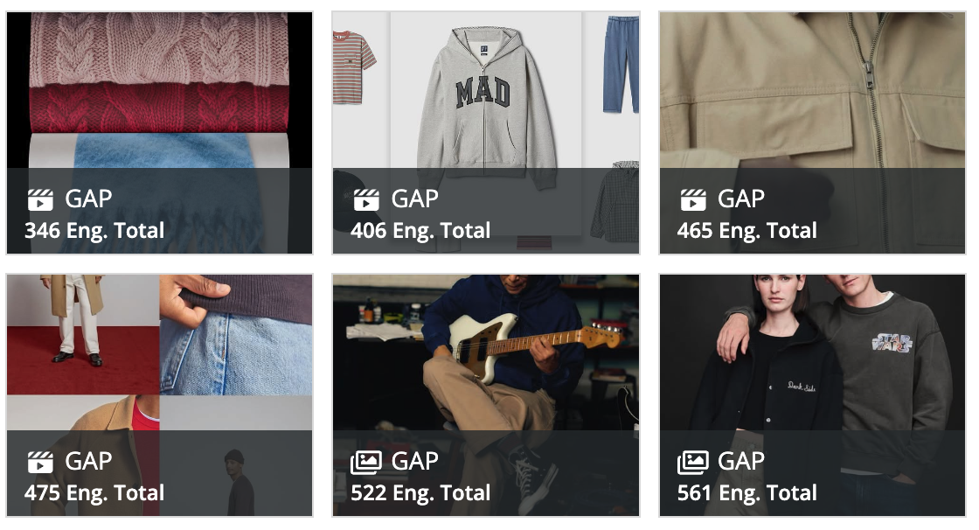
Gap: Top vs. Bottom Posts
Competitor comparison
January 1 – December 31, 2024
TOP POSTS
BOTTOM POSTS
Gap’s top posts showcase a blend of creativity and individuality, from the dynamic #LinenMoves campaign to collaborations with stars like Troye Sivan.
Gap’s lower-performing posts, including campaigns like the DAP collaboration and CashSoft collection, highlight heritage-inspired or practical pieces but lack the energy of their top posts.
Top 6 posts averaged 268.7K engagements per post

Slide 20
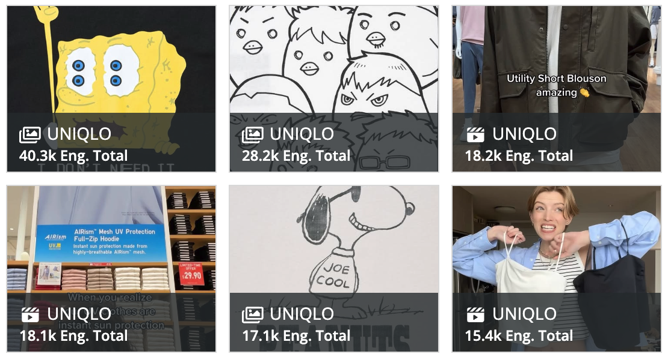
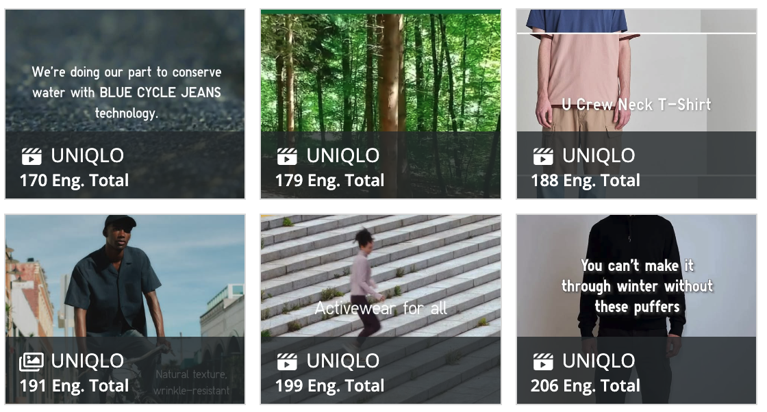
Uniqlo: Top vs. Bottom Posts
Competitor comparison
January 1 – December 31, 2024
TOP POSTS
BOTTOM POSTS
Uniqlo’s top posts nail it with fun collabs and seasonal vibes! From SpongeBob, Snoopy and Haikyuu!! throwbacks to summer-ready looks, they keep things light, playful, and super relatable.
Uniqlo’s least engaging posts emphasize sustainability efforts and niche product campaigns like linen and activewear. While aligned with brand values, they lack the spark of their top content.
Top 6 posts averaged 22.9K engagements per post

Slide 21

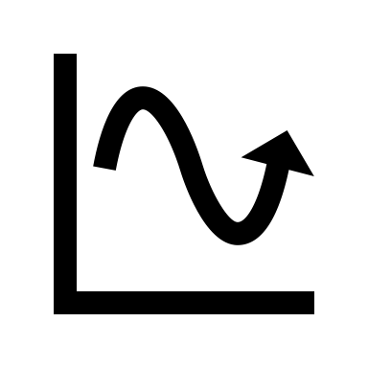


2025 To-Do List
January 1 – December 31, 2024
Zara’s lower posting volume compared to competitors may limit their reach and engagement. Increasing the number of posts, especially around key seasonal campaigns, could amplify their engagement rates and overall impact.
Engagement dips during summer suggest an opportunity to revitalize content during slower periods. Consider launching mini-campaigns or leveraging trending topics to maintain momentum year-round.
Zara’s engagement rate trend mirrors the broader industry pattern, peaking during seasonal moments. Continue aligning campaigns with these moments while experimenting with unique hooks, like influencer collaborations or exclusive launches, to stand out further.
Videos have the highest engagement rate across the landscape but are underutilized by Zara. Test more video posts and explore creative storytelling through Reels and TikToks to capitalize on this format’s potential.

